Slide 1
Fix MFA Outside of Registration Window
January 6th 2022, version 1

Slide 2
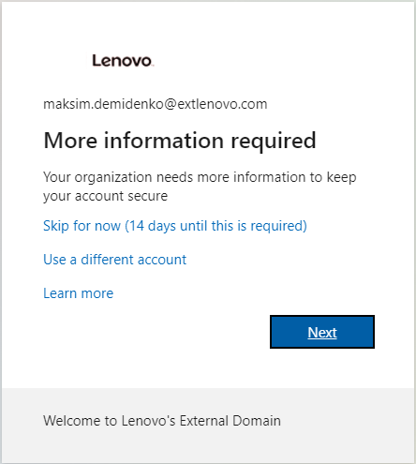
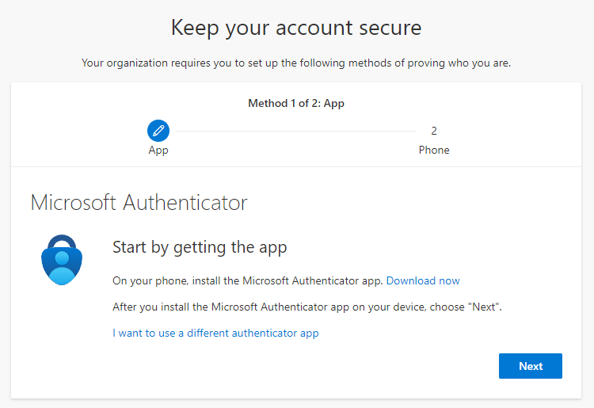
Adding MFA after the deadline
Go to https://login.microsoftonline.com
Click “Next” and you will be prompted to install the app:
  ** Alternate Instructions: If you are not routed as above, you can go directly to https://account.activedirectory.windowsazure.com/proofup.aspx?proofup=1

Slide 3
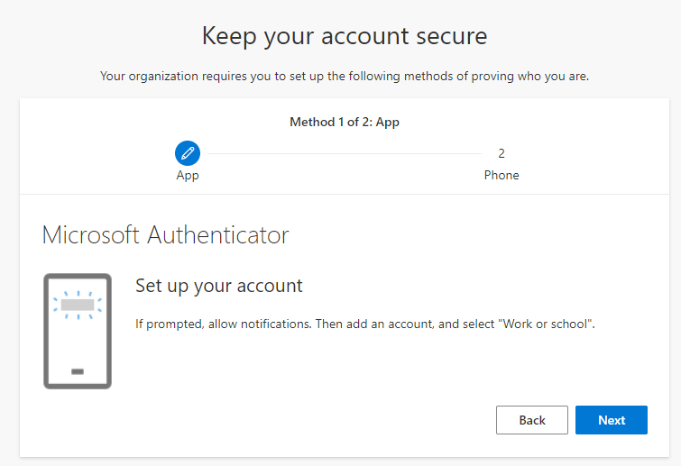
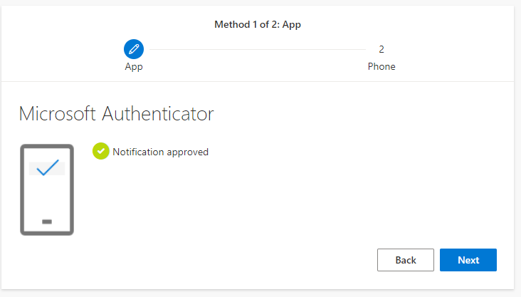
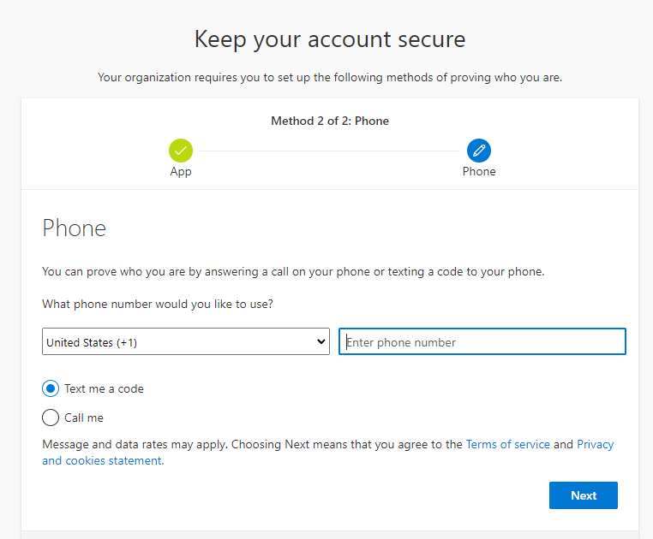
Adding MFA after the deadline
Install the phone application, scan the barcode and approve the login on your phone.
You may also be prompted to setup your telephone number. If you use the “call me” option, this can be an office phone, instead of a mobile device.

Slide 4
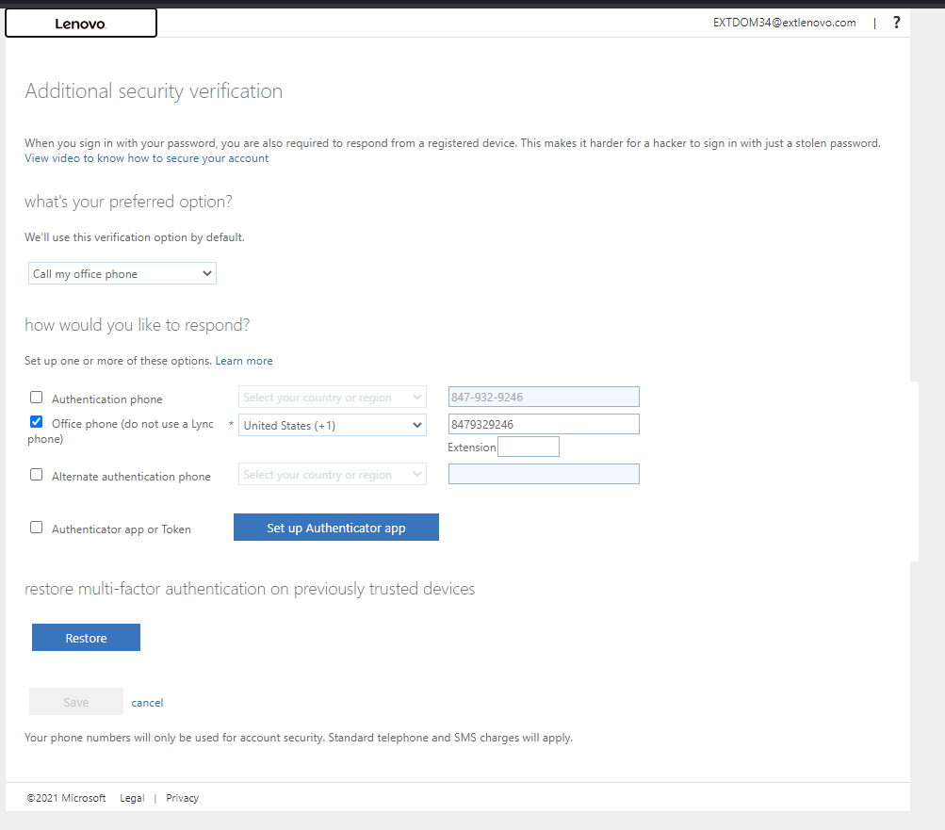
Optional: Adding the office phone and removing the phone app
Go to: https://account.activedirectory.windowsazure.com/proofup.aspx?proofup=1 You will be prompted to use the phone app to authenticate.
Change your settings like below, removing the authentication phone and app. Setup the office phone.
Click Save. You will be prompted to verify the office phone. It will call you and prompt you to enter #.
You are all done!

