Slide 1
MS Locker ID – Add/Update Emails & phones
Aug 28th 2023

Slide 2
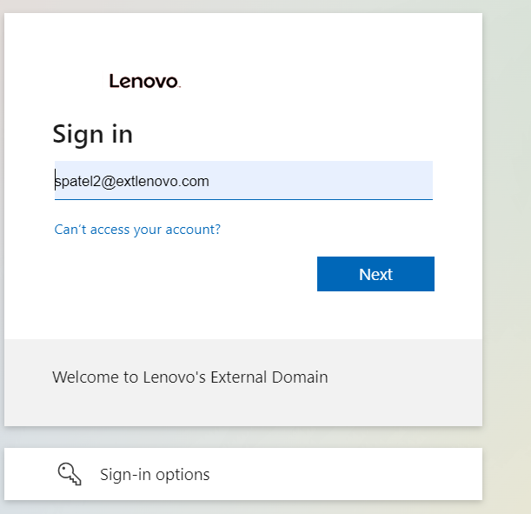
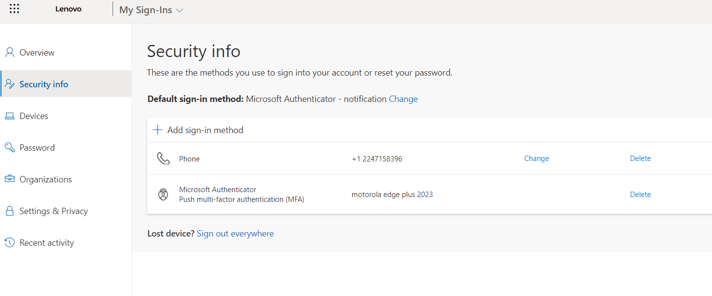
Update Phone /Email /Password
https://account.activedirectory.windowsazure.com/proofup.aspx?proofup=1

Slide 3
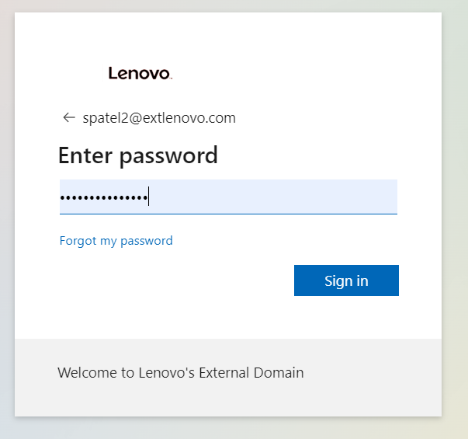
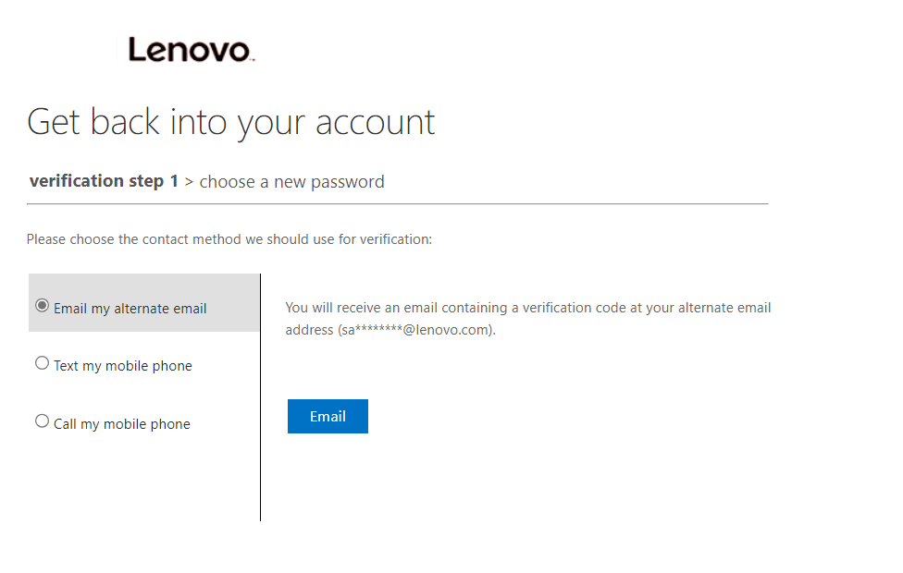
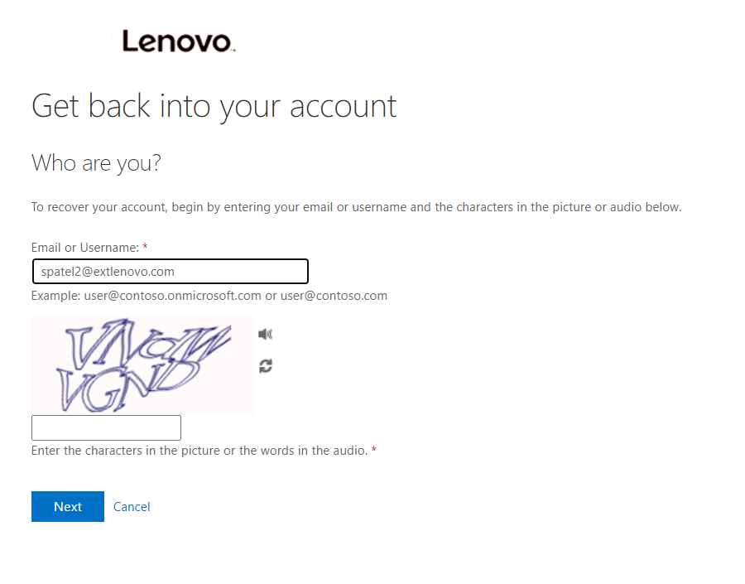
Forgot password options

