Slide 1
Lenovo – Authentication
September 09 2021, version 4

Slide 2
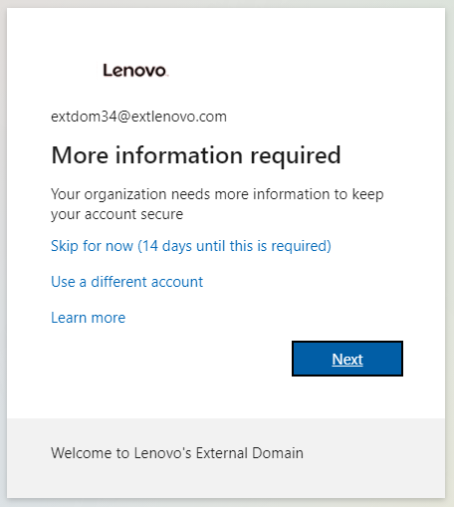
General Guideline
Whenever this pops up, indicating the number of days until it is required, click “Skip for now”. It will popup often until the account is fully setup. If, at some point, you do not click “Skip for now”, logout of the browser and start the process again.
There is a similar screen that does not list the number of days required that should not be skipped.

Slide 3
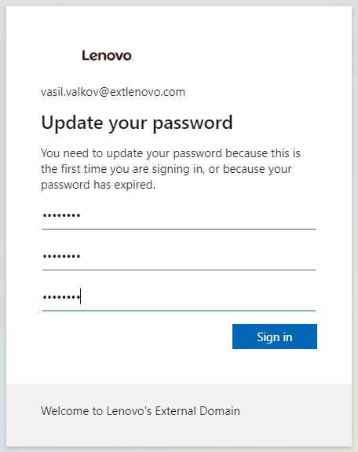
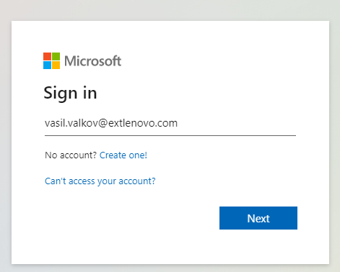
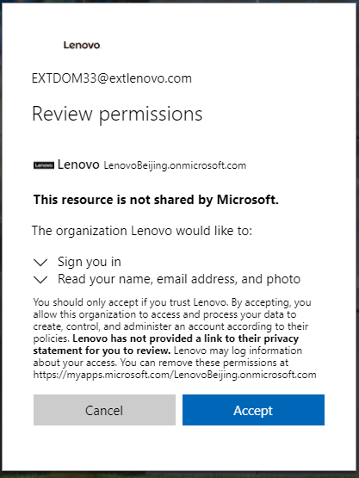
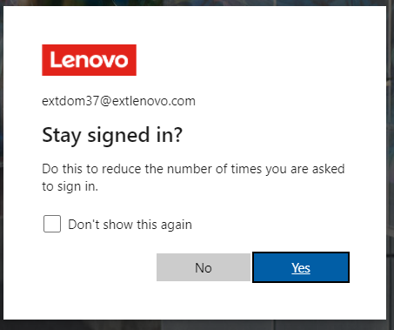
Logging In
If this is the first time you login, use the URL from the email you received that is in this format: https://login.microsoftonline.com/redeem?rd=xxxxxxxxxxxxxxxxxxxxxxx
  This URL only works for your initial invitation acceptance. If you go back to this later, simply use https://login.microsoft.com
  If you are already logged into other Microsoft accounts in the browser, please use an incognito browser or a different browser
Sign in and update your password
Click Accept on the “Review permissions” screen
  This will take you to https://account.activedirectory.windowsazure.com/proofup.aspx?proofup=1 where you can see the MFA you have.
  DO NOT SKIP THE NEXT STEPS. IN 14 DAYS YOUR ACCOUNT WILL REQUIRE THE PHONE AUTHENTICATOR. THERE IS NO WAY TO AVOID IT AT THAT POINT.

Slide 4
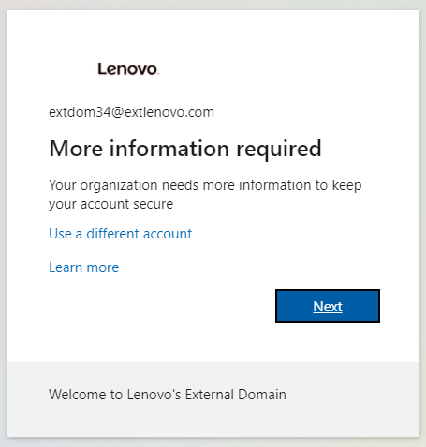
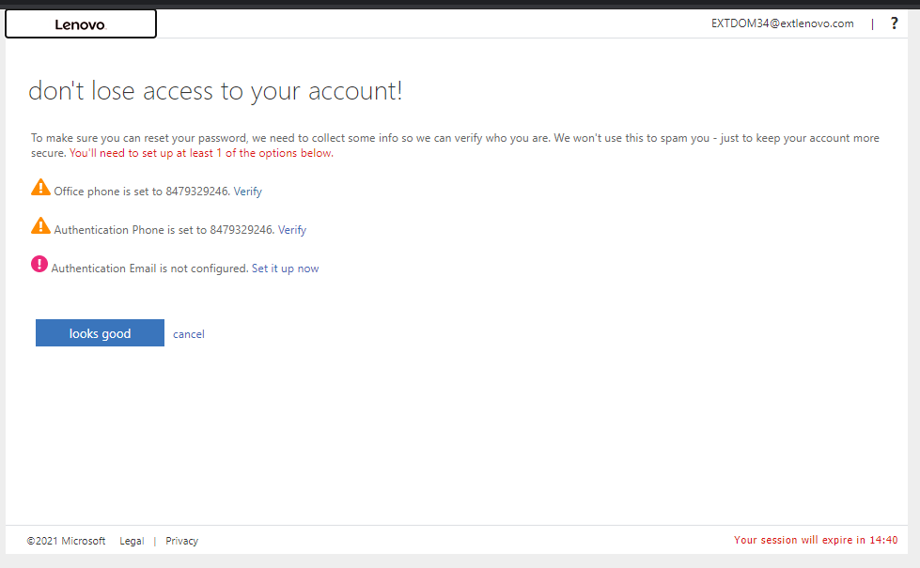
Logging In (Continued)
In the same browser, on a different tab, go to https://login.microsoftonline.com
Click “Skip for now” on the first prompt, but click “Next” on the smaller screen that comes next.
Setup your office phone and authentication email and click “Finish.”

Slide 5

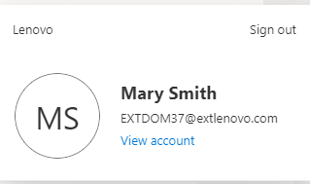
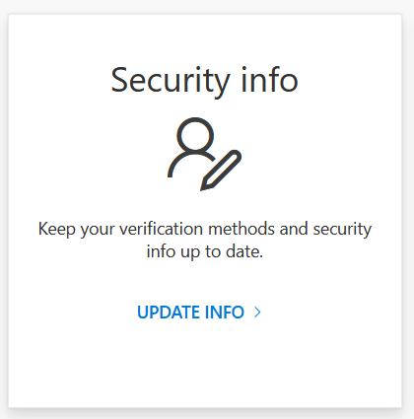
Logging In (Continued)
Click on the avatar by your name in the top right corner
Click View Account
Click Update Info under Security info

Slide 6
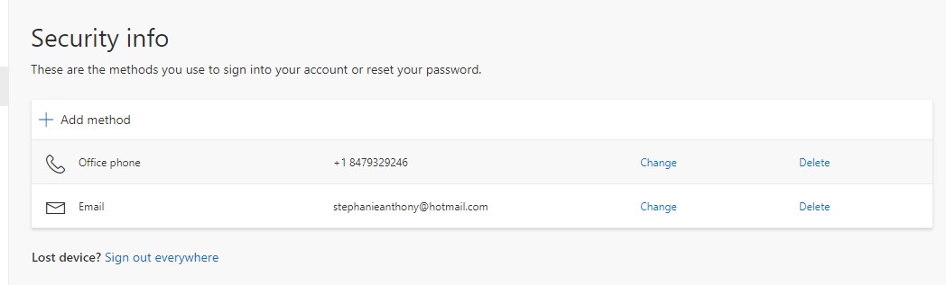
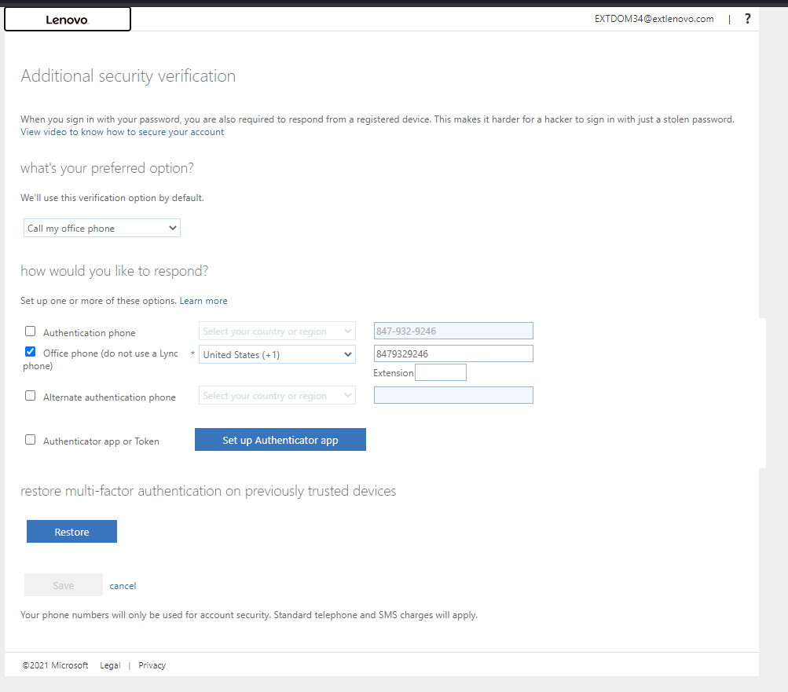
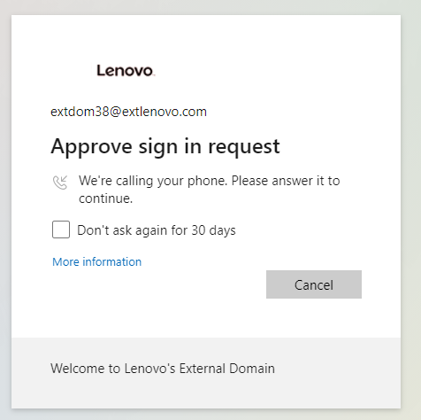
Logging In (Continued)
Add the office phone
Open another tab in the same browser and go to https://account.activedirectory.windowsazure.com/proofup.aspx?proofup=1
If you get to this picture, you are all done!
This is the MFA check

